Slide 1
City of Seattle
Navigation Team

Slide 2
No River Can Return to its Source, Yet All Rivers Must Have a Beginning Native American Saying
November of 2015 Seattle Mayor Ed Murray and King County Executive Dow Constantine Declared States of Emergency for their homeless crises after the death of 66 unhoused individuals
Seattle eventually created a team, reinventing how to outreach to these communities
Police, Outreach, Project Managers, and Hazmat
With the ability to offer shelter, secure property, and make assessments of damage to the environment, this team is encouraging people to move indoors.

Slide 3
Unprecedented Resource Coordination with Partners in Seattle and King County
Public Health, Seattle & King County
Seattle Parks and Recreation
Seattle City Light
Seattle Department of Transportation
Seattle Neighborhoods
Seattle Human Resources
Seattle Public Utilities

Slide 4
Become Culturally Competent through Data “Truly Know Who’s Out There”
In 2017 the percentages by race of those living in shelters consisted of:
African American 40%,
White 31%,
Hispanic 12%,
Multi-racial 6%,
Asian/Pacific Islander 4%,
Native American 2%, with 5% unknown

Slide 5
The Navigation Team Data Collected in 2017 showed similarity
In 2017 the percentages by race of those living in shelters consisted of:
African American 23%,
White 52%,
Hispanic , Latin X 6%,
Multi-racial 2%,
Asian/Pacific Islander 1%,
Native American 4%,
with 7% unknown

Slide 6
Annual One Night Count
The trends show that combined efforts of Puget Sound, including the Seattle/King County Coalition on Homelessness, to provide shelter, healthcare and other help for the homeless are having a positive impact, but that the numbers experiencing homelessness in the region are continuing to climb and, that the response is not adequate.

Slide 7
Individuals Living on the Streets of Seattle
The Count Us In methodology variations-include the level of participation among service providers, people with lived experience of homelessness, community volunteers, and other stakeholders. In particular, special challenges presented in counting and surveying hard-to-reach populations rely on the knowledge and expertise of specialist guides, outreach workers, and service providers participating in count activities.

Slide 8
"While we cannot solve this crisis overnight, we must continue urgent action to make progress.” Jenny Durkin
In 2017, Seattle made $68,098,060 in direct investments in the homeless crisis
In 2018, Seattle is expected to spend around $78 million

Slide 9
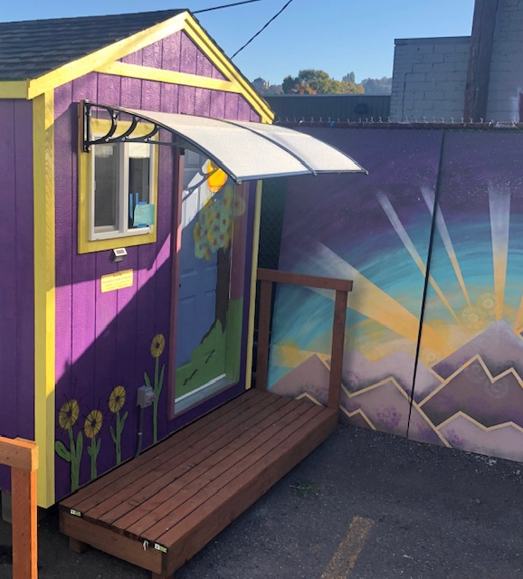
Safer Places Through Bridge Housing
Encampment Villages
Lake Union Village- 22 units (October 2018)
True Hope Village-35 units (September 2018)
Whittier Heights Village- 16 units (May 2018)

Slide 10
Including Greater Services
Enhanced Shelters
The Navigation Center-75 beds
Haddon Hall-75 bed

Slide 11
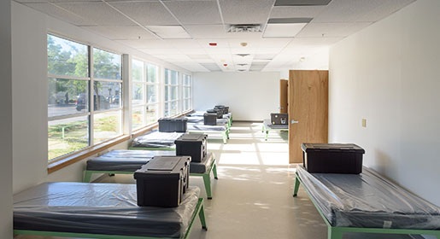
Emergency Shelter Model
Basic Shelter
City Hall Shelter - 80 new beds (July 2018)
Vouchers
YMCA Late Night – 40 new rooms (July 2018)

Slide 12
Good News and Bad News for Affordable Housing in Seattle
Seattle closed out 2018 with over 1,400 affordable housing units in the city’s pipeline for construction and renovation, the largest single-year increase in the city’s history.
Ten new buildings totaling nearly 1,200 apartments and preserving an additional 200-some existing units.
It still isn’t enough.
https://nextcity.org/daily/entry/good-news-and-bad-news-for-affordable-housing-in-seattle
Gregory Scruggs-January 7, 2019
Notes:
Consider talking about:
Medical problems
Violent crimes

Slide 13
Innovation and Activation
The City already had:
A LEAD Team
A Crisis Response Team
It was looking to Create a Hybrid Team to respond to the Unhoused
To offer shelter
To honor their property
To access the camp site for health and safety concerns
To respond to complaints concerning unsanctioned camps
By removing waste
And the restoring intended us of lands
A New Outreach Model

Slide 14
The Navigation Team
Four Field Coordinators
Eight Officers Trained to Perform Outreach
Eight Contracted Outreach Workers
Contracted Clean-up Teams
One Manager who Schedules and Project Manages
One Outreach Coordinator who is a Mental Health Expert. He oversees outreach and project manages intensive outreach engagements

Slide 15
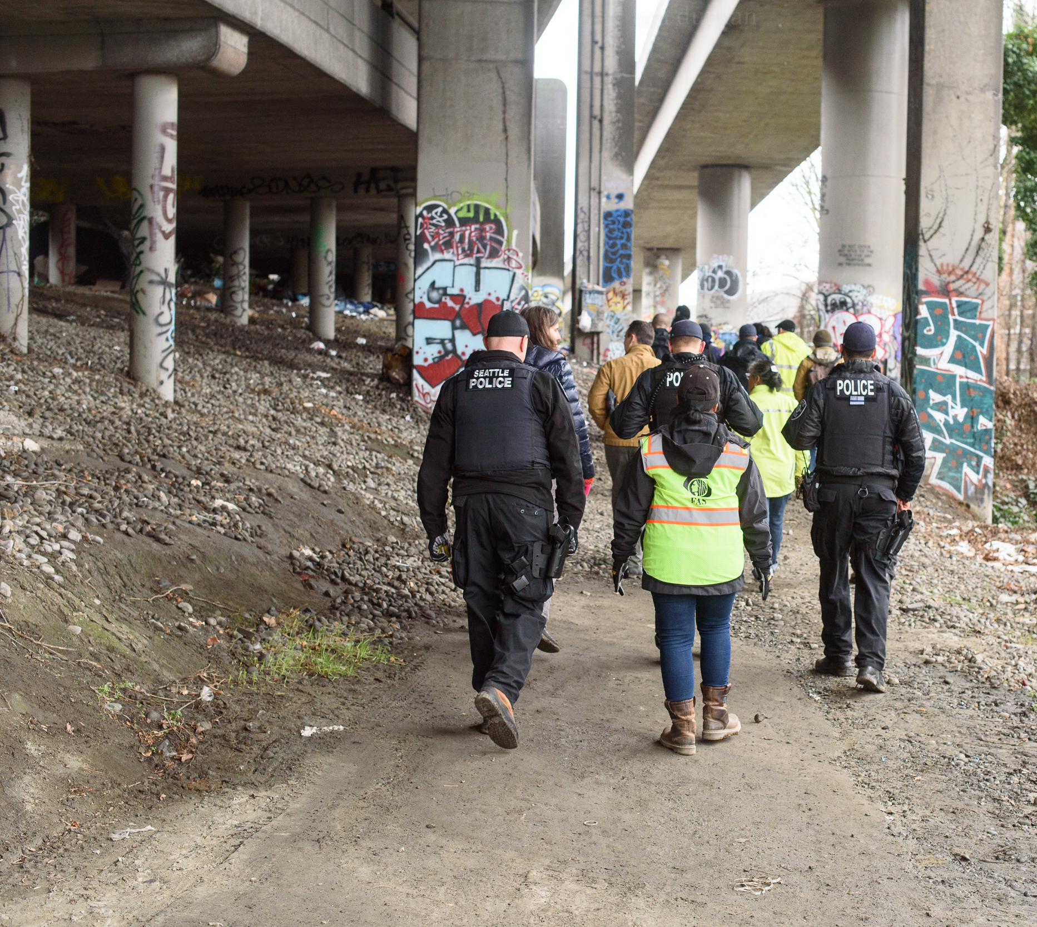
Only in the darkness can you see the stars. Martin Luther King Jr.
In 2018 the team has made:
+10,000 contacts to people living unsheltered
1,314 referrals to shelter
*these figures are unduplicated

Slide 16
I've learned in my life that it's important to be able to step outside your comfort zone and be challenged with something you're not familiar or accustomed to. That challenge will allow you to see what you can do. J.R.Martinez
Guiding the Team’s Practice
Multi-Department Rules (MDAR)
The Multi-Departmental Rule (MDAR) pertaining to the removal of unmanaged encampments was updated in April 2017. The rules were first created in the 2008.
These rules are designed to balance both the rights and needs of people living unsheltered, with the City's responsibility of maintaining public health and safety.
Notes:
Actor and motivational Speaker J.R. Martinez

Slide 17
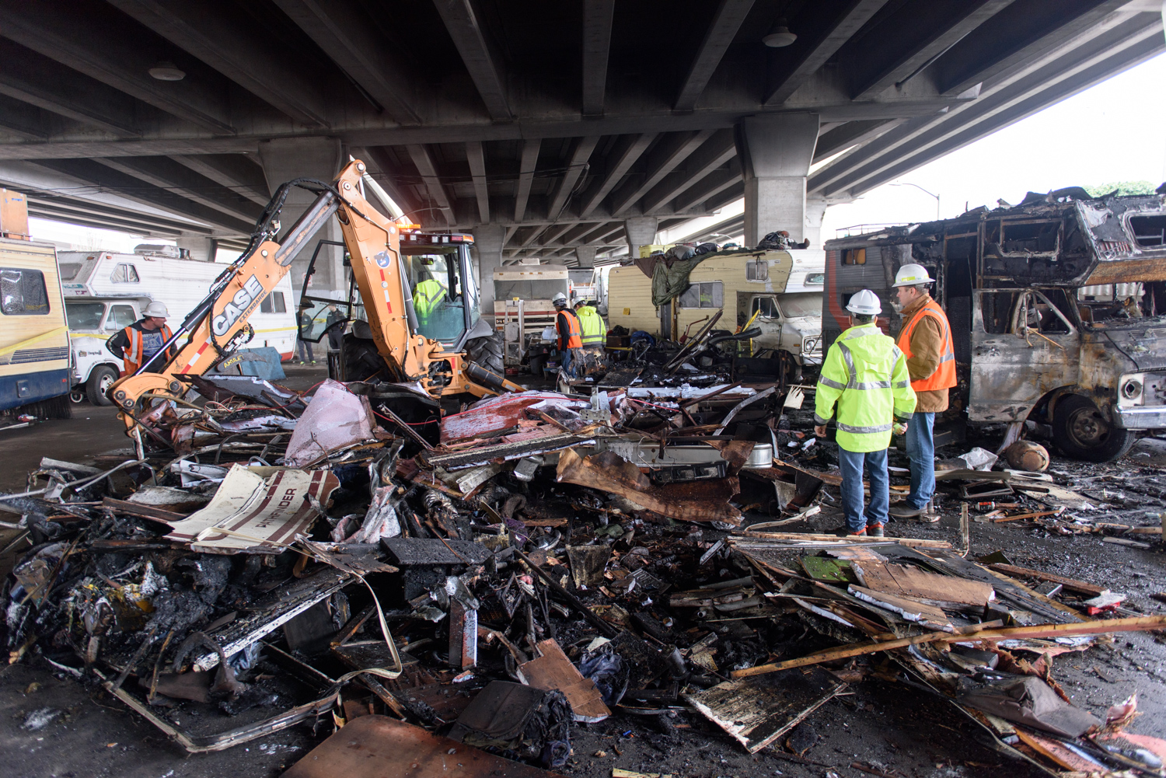
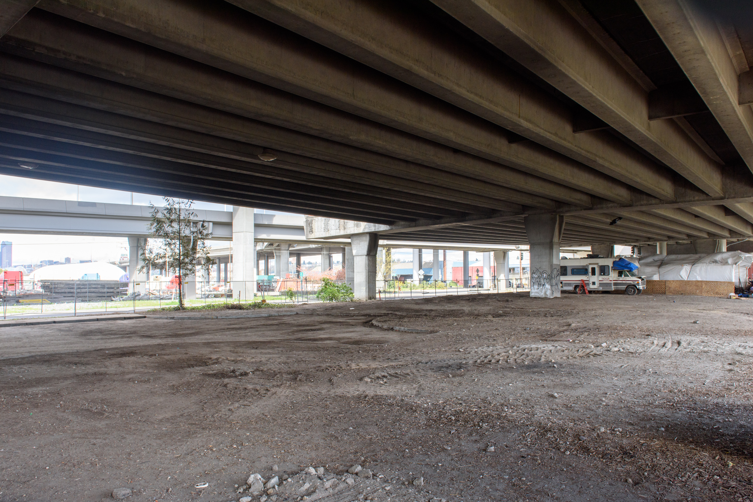
The Rule
The MDARs allow the City, in some scenarios, to provide at least 72-hour removal notice and advanced outreach to encampments on public property, with offers of shelter and storage of personal items.
In other circumstances, the rules call for the City to remove encampments that pose a hazard or an obstruction to public property without 72-hour notice or advanced outreach.

Slide 18
What We Do Well:
More individuals accepting services/alternative housing options
Approximately 35% are opting to leave encampments for shelter
Approximately 65% are opting into some service package
Case management support
Mental health support
Employment support

Slide 19
Mitigation Impacts
Removing Trash from Unmanaged Encampments: In 2018, the City has removed more than 1,184 tons (2,368,000 pounds).
Trash in the right-of-way:. The pilot is designed to engage RV occupants This Pilot has collected 322,556 pounds of trash.
Encampment trash (Litter bag) pilot program: (SPU) The pilot has collected 718,350 pounds of trash - an average of about 31,233 pounds a month.
Syringes: The pilot has collected more than 145,916 syringes.

Slide 20
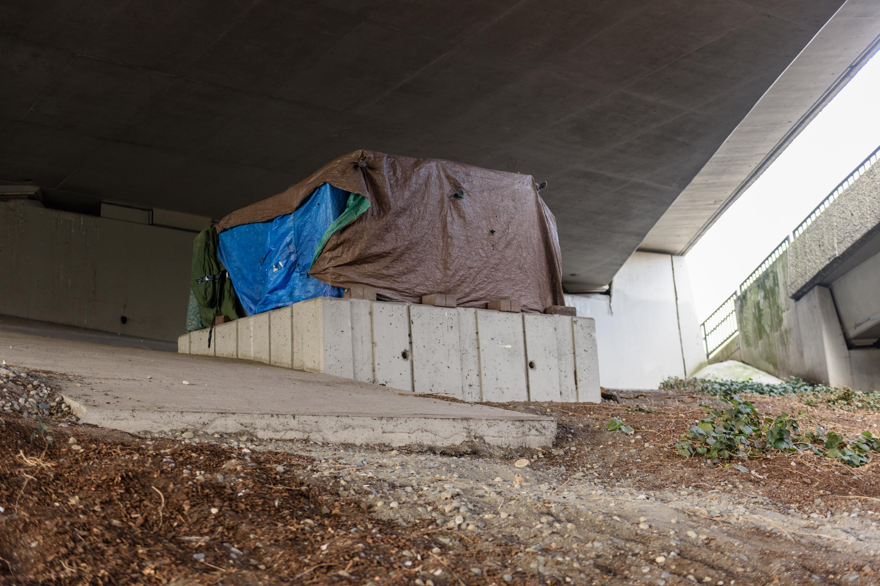
Challenges:
35% maintain and aversion to accepting services
We are still designing to address:
Disproportionality when serving People of Color
Representation of immigrant communities (Latino and East African)
Negatives experiences with providers in the past/ lack of trust

Slide 21
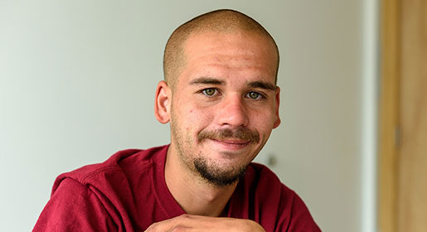
We are offering a place for unsheltered people to find stability and providing the means to connect to housing resources.

Slide 22
For More Information Homelessness Response - Homelessness@Seattle.gov
August Drake-Ericson
Program Operations Manager
City of Seattle Navigation Team
August.drake-Ericson@seattle.gov 206-714-7109

